Slide 1
Chapter 2.7 Creating High-Quality Code
CCSW 325 (Software Construction)
Notes:
Last Update: 22/8/2019
Version 1.0

Slide 2
Outline
High Quality Routines (Part 1 of 3)
What is routine?
Valid reasons to create a routine
Operations that seem too simple to put into routines

Slide 3
What is a Routine?
A routine is an individual method or procedure invocable for a single purpose.
Examples include a function in C++, a method in Java, a function or sub procedure in Microsoft Visual Basic

Slide 4
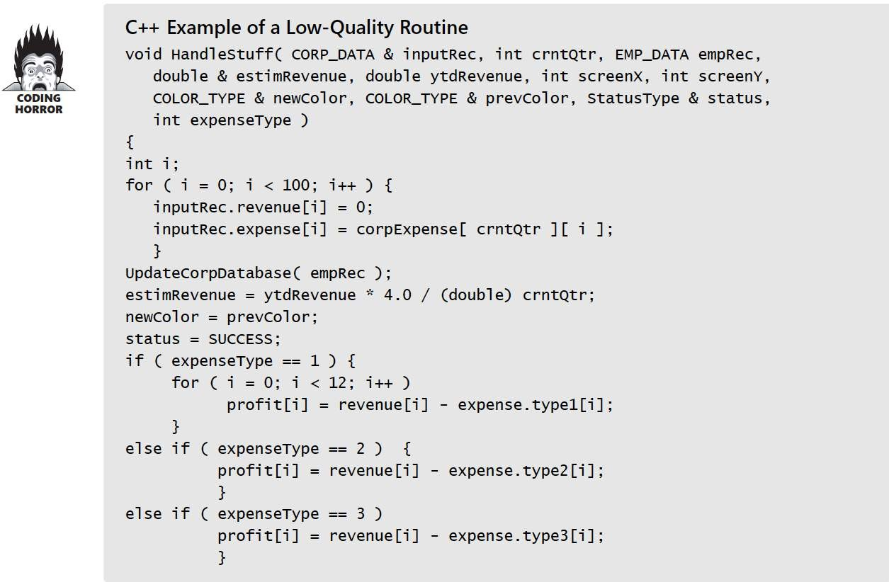
What is a Routine?

Slide 5
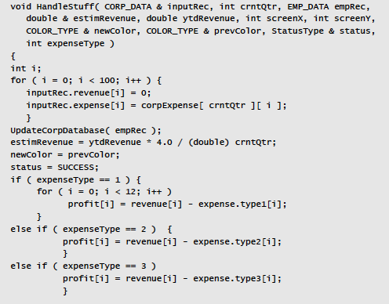
What is a Routine?
The routine has a bad name. HandleStuff() tells you nothing about what the routine does.
The routine isn’t documented.
The routine has a bad layout. The physical organization of the code on the page gives few hints about its logical organization.
The routine’s input variable, inputRec, is changed. If it’s an input variable, its value should not be modified
The routine reads and writes global variables—it reads from corpExpense and writes to profit . It should communicate with other routines more directly than by reading and writing global variables.
The routine doesn’t have a single purpose. It initializes some variables, writes to a database, does some calculations—none of which seem to be related to each other in any way. A routine should have a single, clearly defined purpose.
The routine doesn’t defend itself against bad data. If crntQtr equals 0 , the expression
ytdRevenue * 4.0 / (double) crntQtr causes a divide-by-zero error.
The routine has too many parameters. The upper limit for an understandable number of parameters is about 7
The routine uses several magic numbers: 100 , 4.0, 12 , 2 , and 3 .
The routine’s parameters are poorly ordered and are not documented
Some of the routine’s parameters are unused: screenX and screenY are not referenced within the routine.
One of the routine’s parameters is passed incorrectly: prevColor is labeled as a reference parameter (&) even though it isn’t assigned a value within the routine.

Slide 6
Valid Reasons to Create a Routine
Reduce Complexity
The single most important reason to create a routine is to reduce a program’s complexity.
Create a routine to hide information so that you won’t need to think about it.
Other reasons to create routines: minimizing code size and improving maintainability and correctness

Slide 7
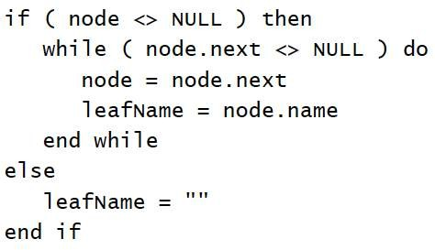
Valid Reasons to Create a Routine
Introduce an intermediate, understandable abstraction
Putting a section of code into a well-named routine is one of the best ways to document its purpose
leafName = GetLeafName( node )

Slide 8
Valid Reasons to Create a Routine
Hide Pointer Operations
Pointer operations tend to be hard to read and error prone. By isolating them in routines, you can concentrate on the intent of the operation rather than on the mechanics of pointer manipulation
if the operations are done in only one place, you can be more certain that the code is correct.
If you find a better data type than pointers, you can change the program without traumatizing the code that would have used the pointers.

Slide 9
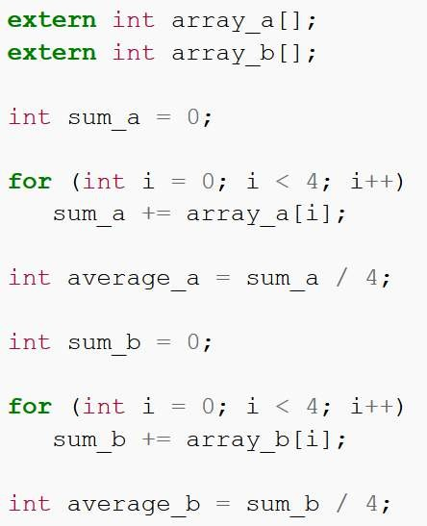
Valid Reasons to Create a Routine
Avoid duplicate code
The most popular reason for creating a routine is to avoid duplicate code.

Slide 10
Valid Reasons to Create a Routine
Hide Sequences
It’s a good idea to hide the order in which events happen to be processed
For example, a sequence might be found when you have two lines of code that read the top of a stack and decrement a stackTopvariable.
Put those two lines of code into a PopStack() routine to hide the assumption about the order in which the two operations must be performed
Hiding that assumption will be better than baking it into code from one end of the system to the other.

Slide 11
Valid Reasons to Create a Routine
Improve portability
Use of routines isolates nonportable capabilities, explicitly identifying and isolating future portability work.
Nonportable capabilities include nonstandard language features, hardware dependencies, operating-system dependencies, and so on.

Slide 12
Valid Reasons to Create a Routine
Simplify Complicated Boolean Tests
Understanding complicated boolean tests in detail is rarely necessary for understanding program flow.
Putting such a test into a function makes the code more readable because:
The details of the test are out of the way and
A descriptive function name summarizes the purpose of the test.
Giving the test a function of its own emphasizes its significance. It encourages extra effort to make the details of the test readable inside its function.

Slide 13
Valid Reasons to Create a Routine
Improve Performance
You can optimize the code in one place instead of in several places.
Centralizing code into a routine means that a single optimization benefits all the code that uses that routine, whether it uses it directly or indirectly.
Having code in one place makes it practical to recode the routine with a more efficient algorithm or in a faster, more efficient language.

Slide 14


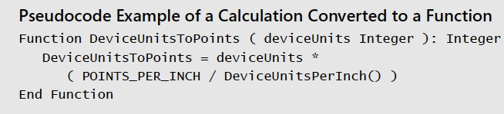
Operations that Seem too Simple to Put Into Routine
Constructing a whole routine to contain two or three lines of code might seem like overkill, but experience shows how helpful a good small routine can be.
Small routines offer several advantages. One is that they improve readability.

Slide 15
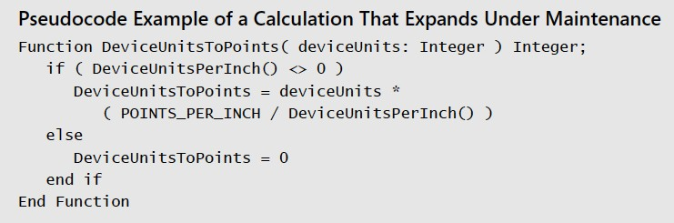
Operations that Seem too Simple to Put Into Routine
If that original line of code had still been in a dozen places, the test would have been repeated a dozen times, for a total of 36 new lines of code. A simple routine reduced the 36 new lines to 3.

Slide 16
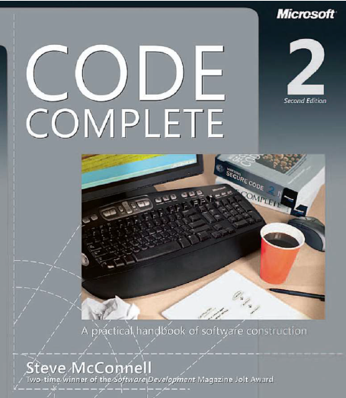
Reading
Code Complete: A Practical Handbook of Software Construction, 2nd Edition, Steve McConnell.
Chapter 7

Slide 17

Any questions? ​
Please feel free to raise your hands and ask.

